Slide 1

SWIFT On Mobile

Slide 2
Business Travel Request
SWIFT On Mobile
Associate *
Submit Travel Request
Manager
Approval by Manager
Associate *
Submit Insurance Request
Admin
Tickets, Insurance, Forex, Accommodation processed
Accept Ticket Itinerary
Issue Insurance
Issue Tickets
Book Accommodation (Domestic)
Issue Forex
Output
In Scope
Box Marked in Green are in scope
2
Internal |RBEI/BSM4 27.05.2020
© Robert Bosch GmbH 2016. All rights reserved, also regarding any disposal, exploitation, reproduction, editing, distribution, as well as in the event of applications for industrial property rights.

Slide 3
Info Travel Request
SWIFT On Mobile
Associate *
Submit Travel Request (Family Can be Included)
Manager
Appr8oval by Manager
Associate *
Submit Insurance Request
Admin
Tickets, Insurance ,Forex, Accommodation processed
Accept Ticket Itinerary
Issue Insurance
Output
Issue Tickets
Book Accommodation (Domestic)
Issue Forex
In Scope
Box Marked in Green are in scope
Info Travels can be available if employee is planning for a transfer to other entity
3
Internal |RBEI/BSM4, ||27.05.2020
© Robert Bosch GmbH 2016. All rights reserved, also regarding any disposal, exploitation, reproduction, editing, distribution, as well as in the event of applications for industrial property rights.

Slide 4
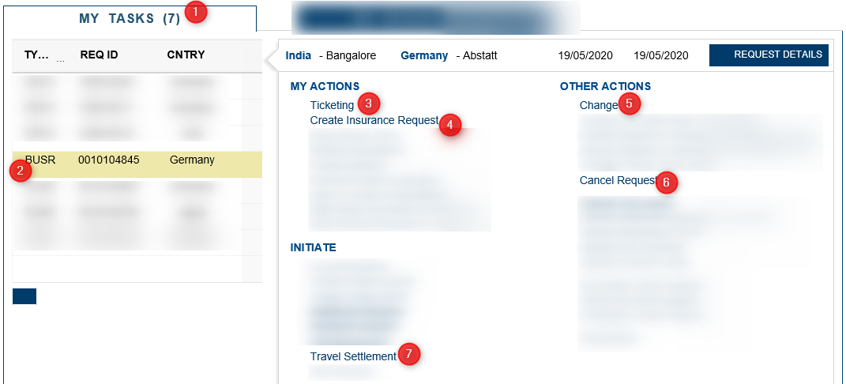
Scope – Phase 1
SWIFT On Mobile
Phase1 will have the following features
My Tasks – User can view the requests
Create Business Travel request
Ticketing
Insurance Request
Change request
Cancel Request
4
IInternal |RBEI/BSM4, ||27.05.2020
© Robert Bosch GmbH 2016. All rights reserved, also regarding any disposal, exploitation, reproduction, editing, distribution, as well as in the event of applications for industrial property rights.

Slide 5
Scope – Phase 2
SWIFT On Mobile
Phase 2 will have the following features
Travel settlement Request
Employee should be able to submit the Travel settlement request
5
IInternal |RBEI/BSM4, ||20.04.2020
© Robert Bosch GmbH 2016. All rights reserved, also regarding any disposal, exploitation, reproduction, editing, distribution, as well as in the event of applications for industrial property rights.

Slide 6
Scope : Business Travel Request , Info Travel Request
SWIFT On Mobile
My Tasks – User can view the requests and initiate necessary actions
Create Business Travel request
All the fields currently available in web Application, same should be made available in FIORI App .
Associate should be able to create, save and submit the request as in current Web Application
Ticketing
Associate should be able accept/ send back the itinerary as in current Web Application
Insurance
Associate should Create/submit /change the Insurance Request as in current Web Application
Cancel Request
Associate should be able to submit the Cancellation Request as in current Web Application
Change in Date
Associate should be able to raise the request for Change in date as in current Web Application
Status of the request should be displayed
Travel Settlement
Creation and Submission of Travel settlement request
*Note: There will not be any changes/functionality to the fields from existing application for all the processes
6
IInternal |RBEI/BSM4, ||20.04.2020
9
© Robert Bosch GmbH 2016. All rights reserved, also regarding any disposal, exploitation, reproduction, editing, distribution, as well as in the event of applications for industrial property rights.

Slide 7
Not in Scope
SWIFT On Mobile
Creation of Deputation Request , Home Trip ,Emergency Request ,Secondary Travel
Approval Process
Admin Related Activities (Issue of Ticket , Insurance ,Arranging for Accommodation, Issue Forex)
7
Internal |RBEI/BSM4, ||27.05.2020
© Robert Bosch GmbH 2016. All rights reserved, also regarding any disposal, exploitation, reproduction, editing, distribution, as well as in the event of applications for industrial property rights.

Slide 8
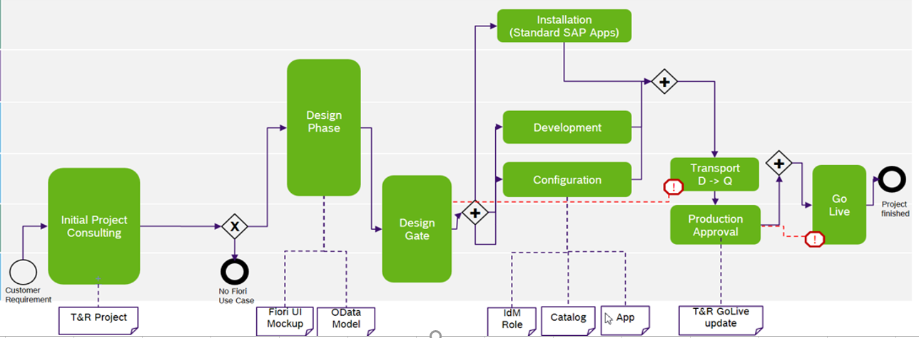
Development Process
SWIFT On Mobile
8
Internal |RBEI/BSM4 27.05.2020
© Robert Bosch GmbH 2016. All rights reserved, also regarding any disposal, exploitation, reproduction, editing, distribution, as well as in the event of applications for industrial property rights.

Slide 9
Organizational Units and Tasks
SWIFT On Mobile
Project Lead
Contract
Plan
Plan
Plan
Fiori
Designer & Prototyper
(RBEI SWIFT Team)
Fiori Configurator/Expert RBEI SWIFT Team, CI/DAE3
Fiori UI/Odata Developer (RBEI SWIFT Team
Fiori Core Team
App Dev
CI/DAE3
Initial Project Consulting
Design Check (UI Approvals, Catalog & Role Design)
Quality Checks (e.g. OData & SAPUI5 Code Review, OSS scan, UI review)
Provide development environment (WebIDE, Build)
Screen Design
Create Fiori Prototype with SAP Build
Fiori Development co-ordination & configuration
Application Base Setup
Service registration (Front-End server)
Launchpad Configuration
Application role management (Portal & Front-End & Back-End server)
Portal Application Integration Process
Transport Management
Extend or implement Fiori application
Odata Service development (incl. backend logic)
Back-End customizing
9
Intern |RBEI/BSM4 27.05.2020
© Robert Bosch GmbH 2016. Alle Rechte vorbehalten, auch bzgl. jeder Verfügung, Verwertung, Reproduktion, Bearbeitung, Weitergabe sowie für den Fall von Schutzrechtsanmeldungen.

Slide 10
Timeline : Phase 1
SWIFT On Mobile
Milestone | Responsible | Planned Start Date | Planned Completion Date
Initail Project Consulting with CI/DAE3 | SWIFT Tech Team | 01.06.2020 | 26.06.2020
Mockup Screen Design | SWIFT Tech Team | 01.06.2020 | 26.06.2020
Create FIORI Prototype | SWIFT Tech Team | 01.06.2020 | 26.06.2020
Screen Design Approval | ICO/CI | 22.06.2020 | 26.06.2020
Design Checks – UI Approval, Role Design and Catalog | SWIFT Tech Team , CI/DAE3 | 29.06.2020 | 03.07.2020
Development | SWIFT Tech Team | 06.07.2020 | 31.08.2020
Launchpad Configuration | SWIFT Tech Team , CI/DAE3 | 01.09.2020 | 07.09.2020
Portal Integration | SWIFT Tech Team , CI/DAE3 | 01.09.2020 | 07.09.2020
Application Role Management | RBEI/BSR3 | 06.07.2020 | 31.08.2020
Quality Checks – Code Review, UI Review | SWIFT Tech Team ,CI/DAE3 | 24.08.2020 | 31.08.2020
Functional and Integration Testing | SWIFT Tech Team | 01.09.2020 | 18.09.2020
UAT | Process Owners | 14.09.2020 | 25.09.2020
Cutover Activites and Production Release | SWIFT Tech Team | 25.09.2020 | 30.09.2020
10
Intern |RBEI/BSM4 27.05.2020
© Robert Bosch GmbH 2016. Alle Rechte vorbehalten, auch bzgl. jeder Verfügung, Verwertung, Reproduktion, Bearbeitung, Weitergabe sowie für den Fall von Schutzrechtsanmeldungen.

Slide 11
Flat Hands Icon Set
SWIFT On Mobile
Thank You
11
Internal |RBEI/BSM4 27.05.2020
© Robert Bosch GmbH 2016. All rights reserved, also regarding any disposal, exploitation, reproduction, editing, distribution, as well as in the event of applications for industrial property rights.

